Slide 1
Working with the Web Part Property Pane
Building custom property pane fields

Slide 2

Introducing the Property Pane
Add custom property pane field
Creating custom property pane controls

Slide 3
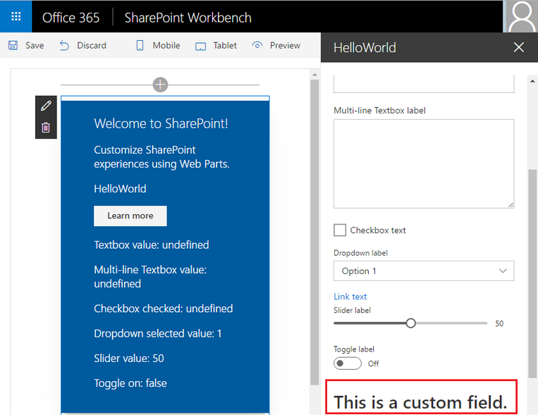
Overview
Property pane supports the following field types out-of-the-box
Label
Textbox
Multi-line Textbox
Checkbox
Dropdown
Link
Slider
Toggle
Custom
Also possible to create your own custom field types

Slide 4
Implementing custom property pane fields
Define an interface in your web part that includes one or more target properties
Import PropertyPaneCustomField field type in the web part class
PropertyPaneCustomField field type is available as a modules in the @microsoft/sp-webpart-base library

Slide 5
Implementing custom property pane fields
// Web Part: create a render method for the custom field
private _customFieldRender(elem: HTMLElement): void {
elem.innerHTML = '<div><h1>This is a custom field.</h1></div>’;
}
// Add custom field definition in a groupFields array
protected get propertyPaneSettings(): IPropertyPaneSettings {
return {
pages: [
{
header: { description: strings.PropertyPaneDescription},
groups: [
{
groupName: strings.BasicGroupName,
groupFields: [
PropertyPaneCustomField('customField', {
onRender: this._customFieldRender.bind(this)
}),
]
} ] } ]
}
}

Slide 6
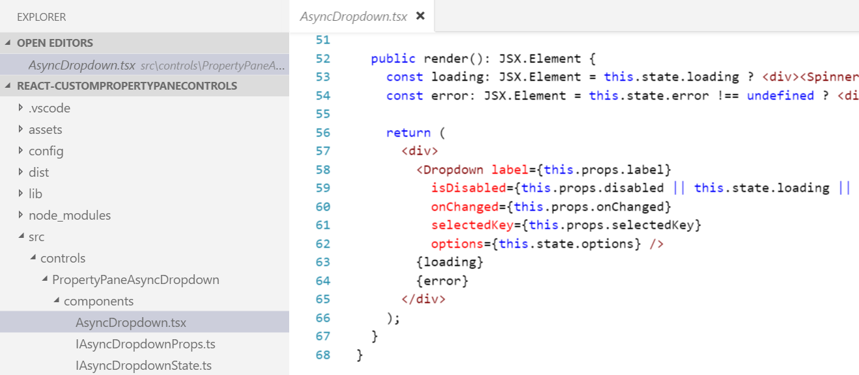
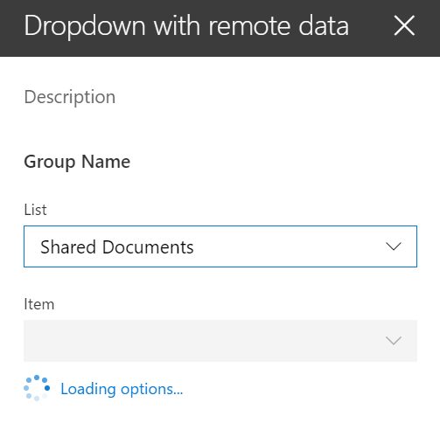
Creating custom property pane controls
When out-of-the-box property pane controls don’t meet your needs you can create your own custom controls
Creating custom controls promotes code reusability
https://github.com/SharePoint/sp-dev-fx-webparts/tree/master/samples/react-custompropertypanecontrols

Slide 7
Demo Building custom property pane fields

Slide 8

Summary
Add custom property pane field
Creating custom property pane controls

Slide 9
Reading further
Overview of the SharePoint Framework
https://docs.microsoft.com/sharepoint/dev/spfx/sharepoint-framework-overview
Make your SharePoint Client-Side Web Part Configurable
https://docs.microsoft.com/sharepoint/dev/spfx/web-parts/basics/integrate-with-property-pane
Build Custom Controls for the Property Pane
https://docs.microsoft.com/sharepoint/dev/spfx/web-parts/guidance/build-custom-property-pane-controls

Slide 10
Thank you.

